Slide 1
Creating a Publishing Company in 2019
Insights from the Seattle Public Library
Hardik Patel, John McGee, Veeraj Jadeja, Kieran Buckley

Slide 2
Background
We are a startup publisher conducting preliminary research
Public Library Systems in America as a whole account for one of the largest exchanges of published material in the world
The Seattle Public Library System is the 17th most visited in the US (excluding University Libraries) with over 5.4 million visits per year¹ and possess a collection of over 2.3 million items²
Serves a population of approximately 686,800, with over 378,000 members²

Slide 3
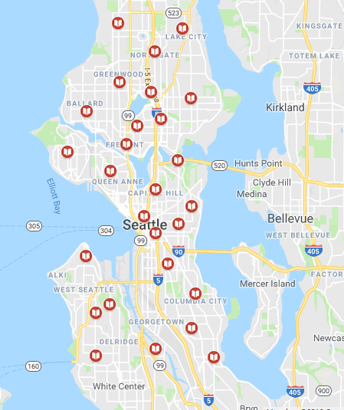
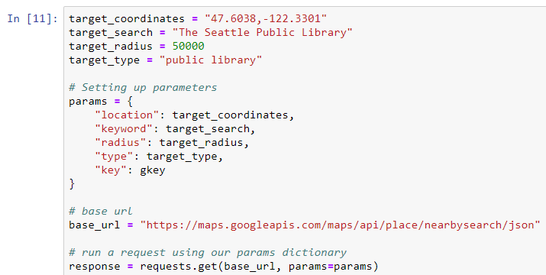
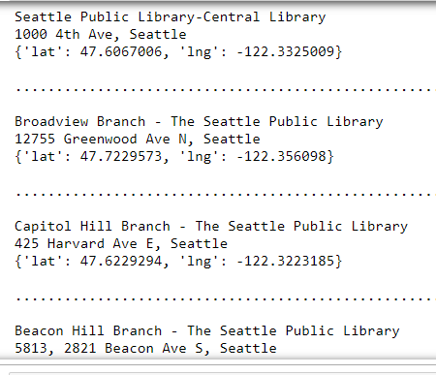
The Seattle Public Library Locations

Slide 4
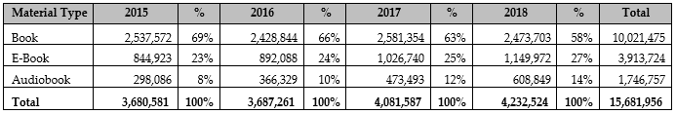
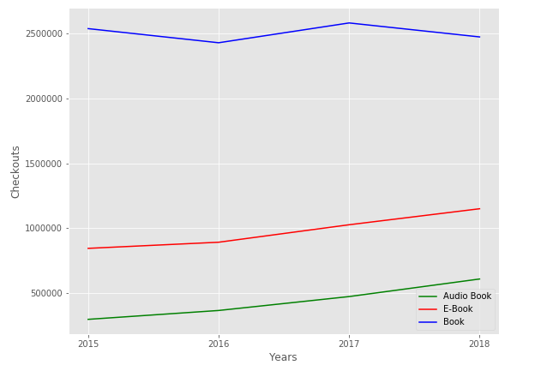
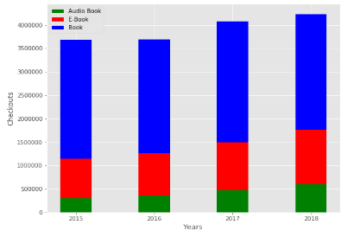
In what format are people consuming material and how is it changing over time?
Checkouts By Material Type and Year

Slide 5
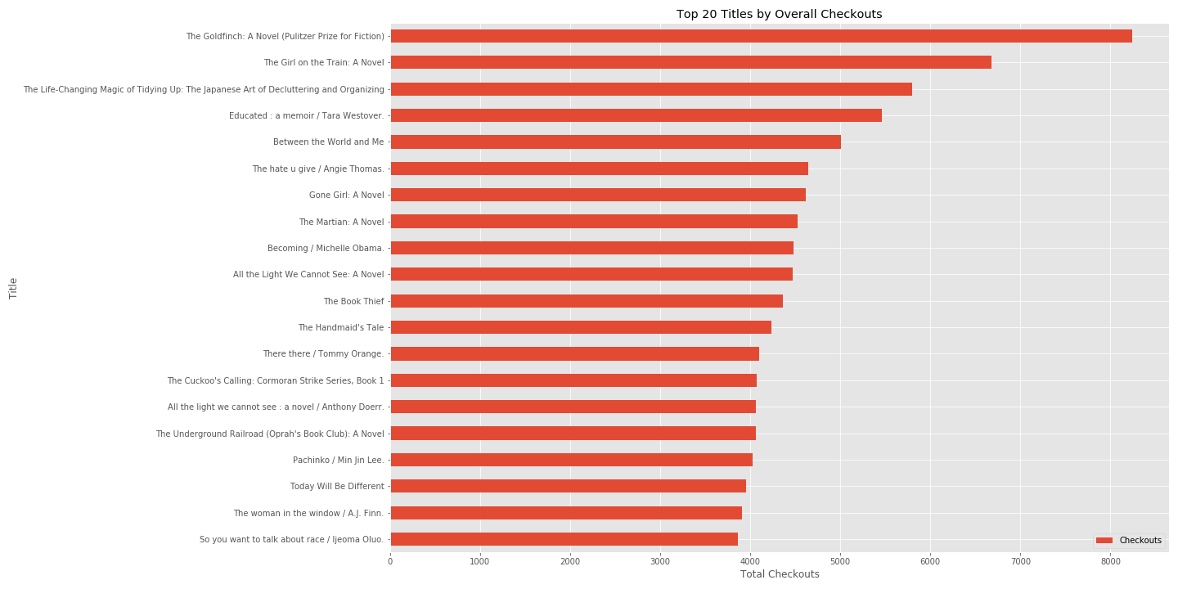
Most Popular Checked Out Titles (Total)

Slide 6
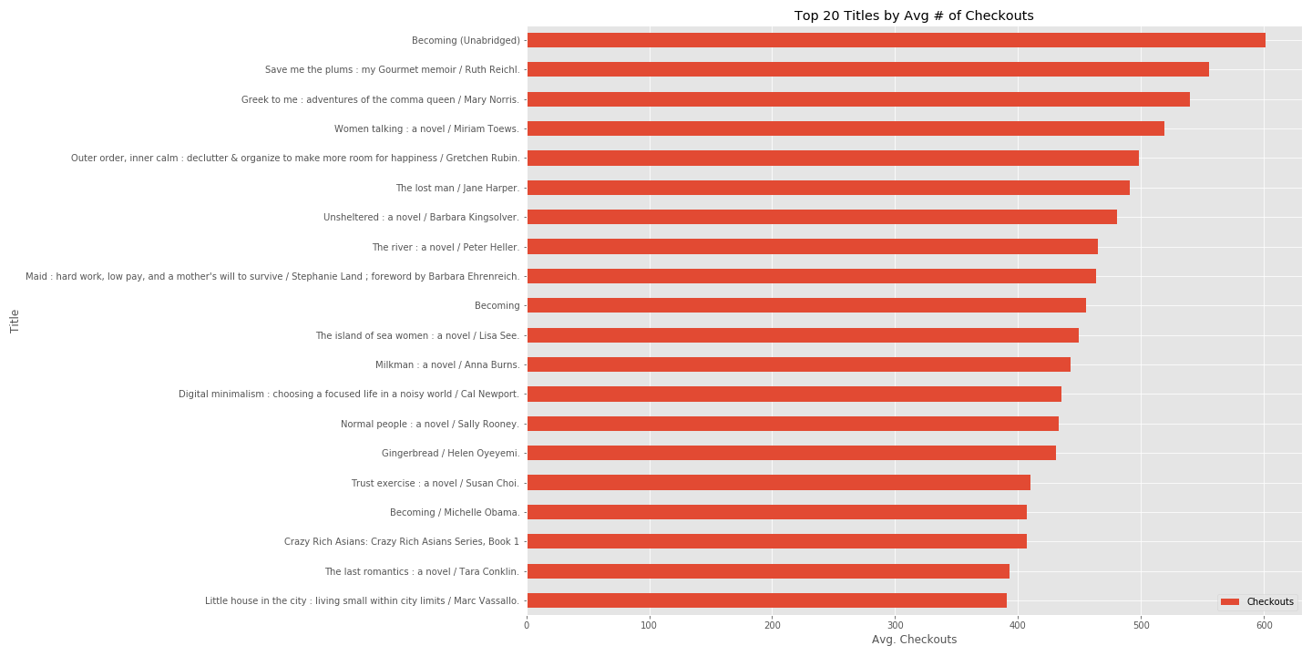
Most Popular Checked Out Titles (Average Volume)

Slide 7
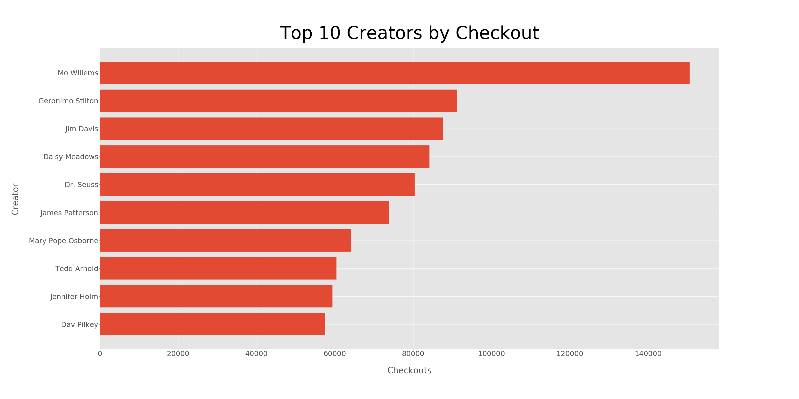

Slide 8
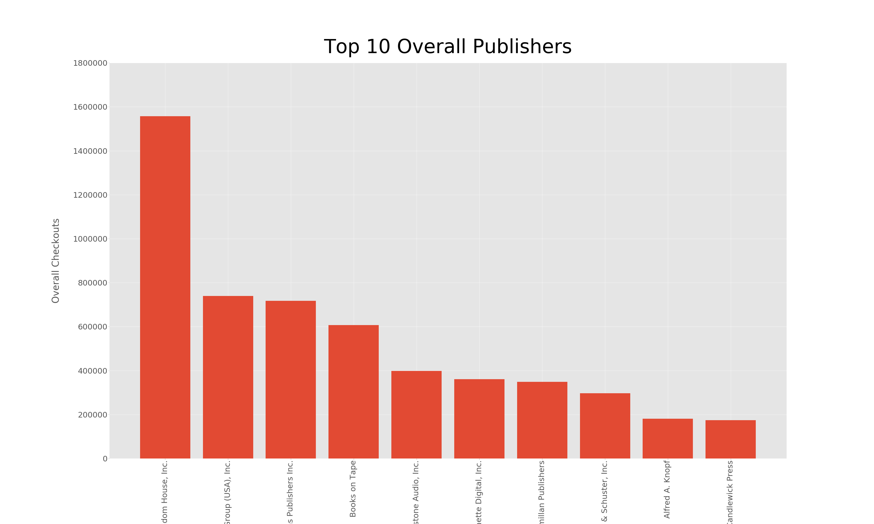
Random House, Inc.
Penguin Group (USA), Inc.
HarperCollins Publishers, Inc.
Books on Tape
Blackstone Audio, Inc.
Hachette Digital, Inc.
Macmillan Publishers
Simon & Schuster, Inc.
Alfred A. Knopf
Candlewick Press

Slide 9
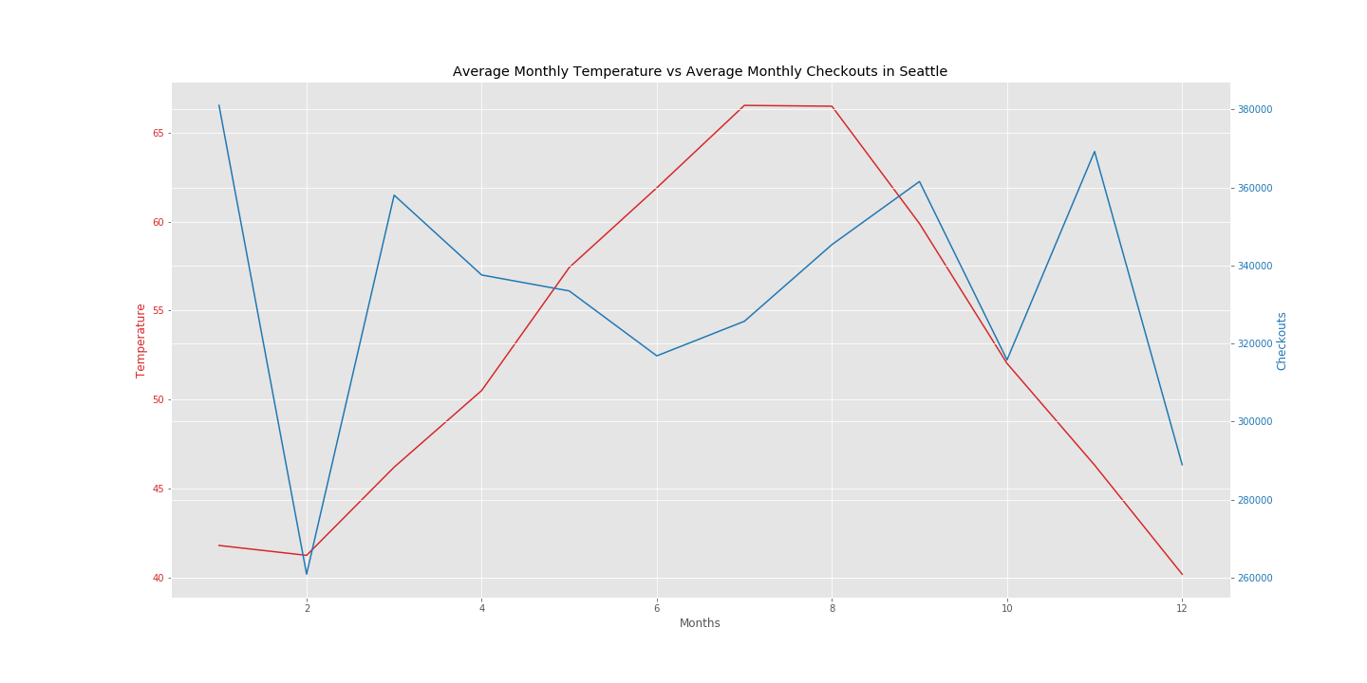
Is there a correlation between weather and checkouts?

Slide 10
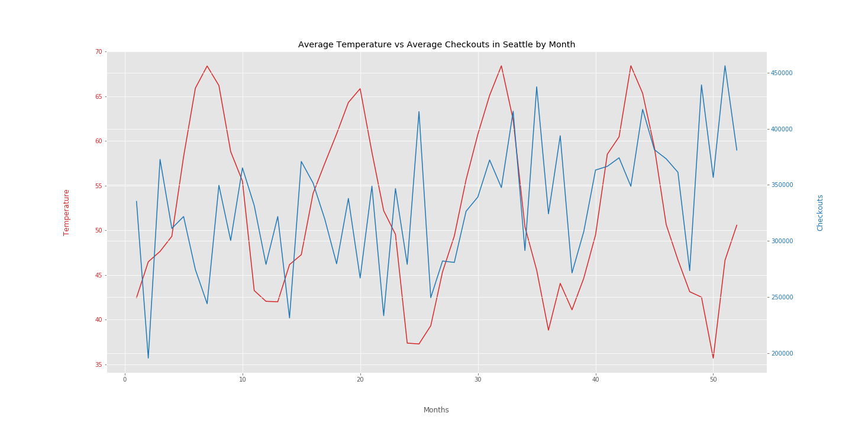
Is there a correlation between weather and checkouts?

Slide 11
Data Limitations
Book sales data is actually extremely difficult to come by
Amazon only publicly tracks last 4 weeks and shuts down people who try to use it's API for tracking purposes
Major players are NPD which offer paid enterprise level solutions (industry research) and various top 10 lists that are usually weekly/monthly (New York Times/PublishersWeekly)
Startup publisher would probably want to first stitch together public (and free) datasets to try to make predictions instead of immediately blowing $$$$ on expensive alternatives

Slide 12
References
"2016 Washington Public Library Statistical Report" (PDF). Washington State Library. October 2017. Retrieved 05, July 2019.
“Seatle Public Library.” Wikipedia: The Free Encyclopedia. Wikipedia, The Free Encyclopedia, 11, June 2019. Web. 05, July 2019,https://en.wikipedia.org/wiki/Seattle_Public_Library
Open Weather, https://openweathermap.org/api
kaggle.com, Seattle Checkouts by TitleFrom City of Seattle Open Data, https://www.kaggle.com/city-of-seattle/seattle-checkouts-by-title
The Seattle Public Library, https://www.spl.org/

